Slide 1
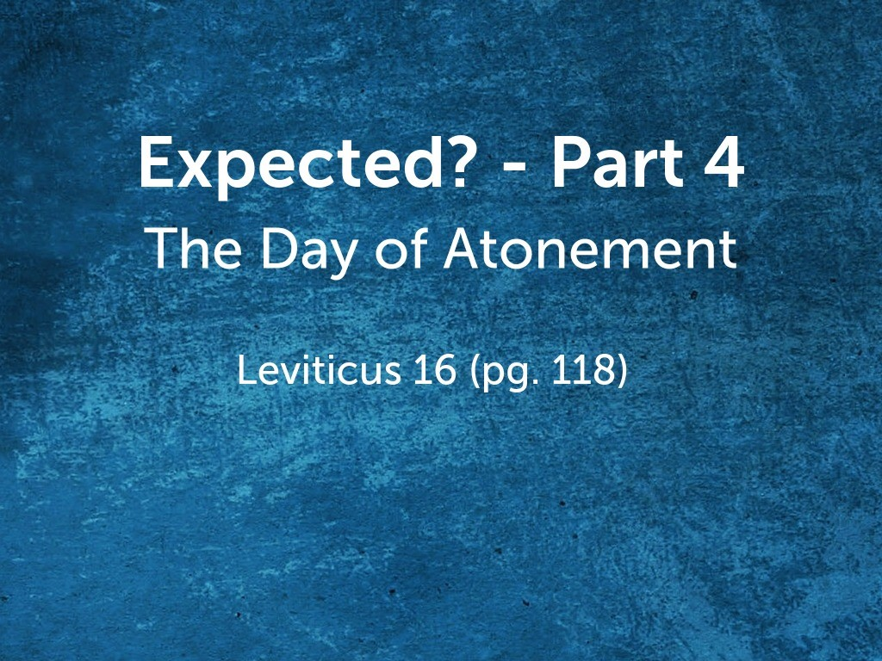

Slide 2
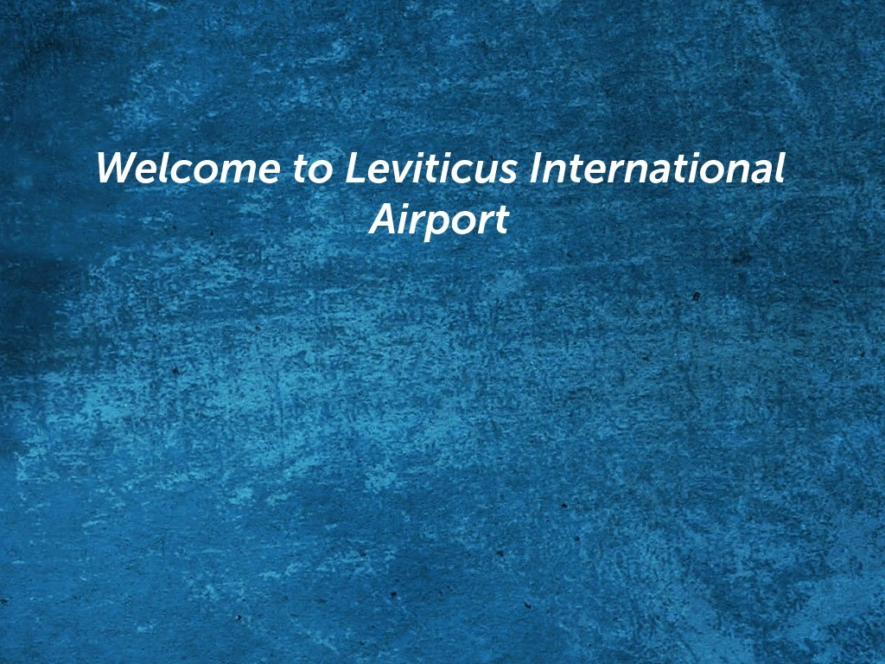
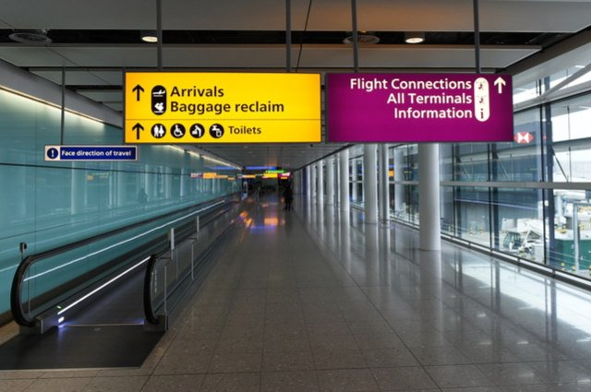

Slide 3
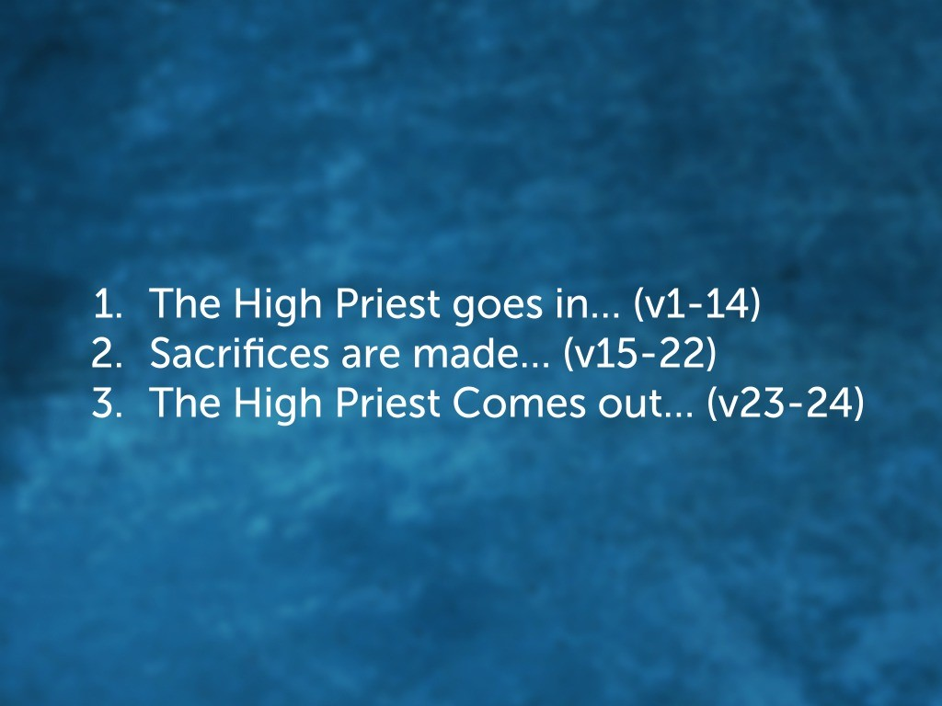

Slide 4
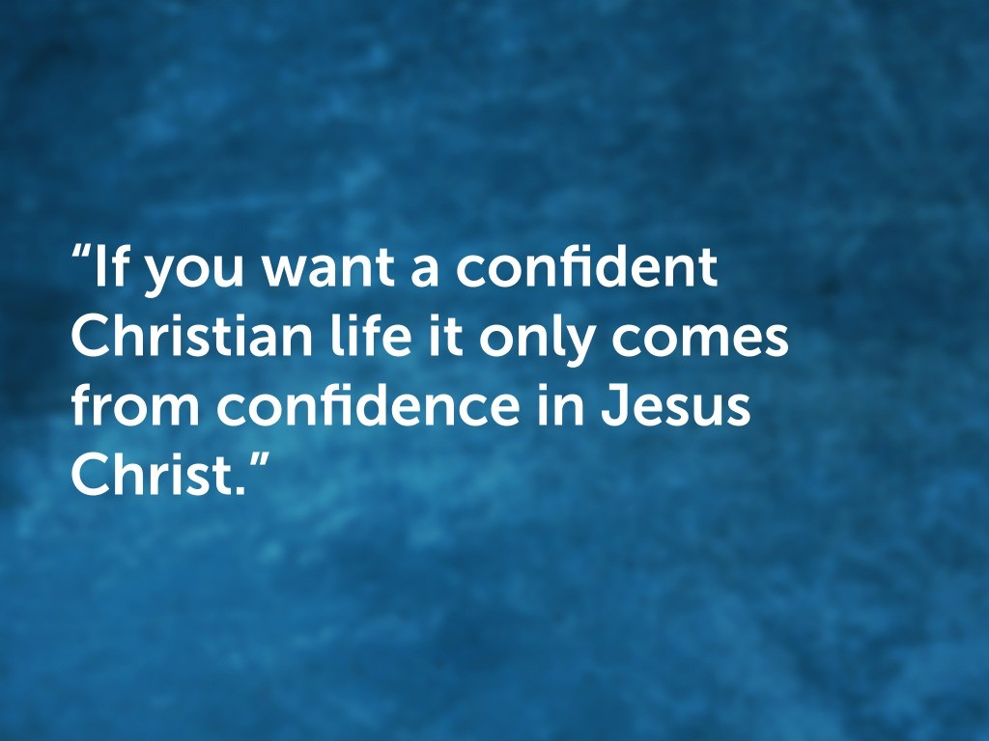

Slide 5
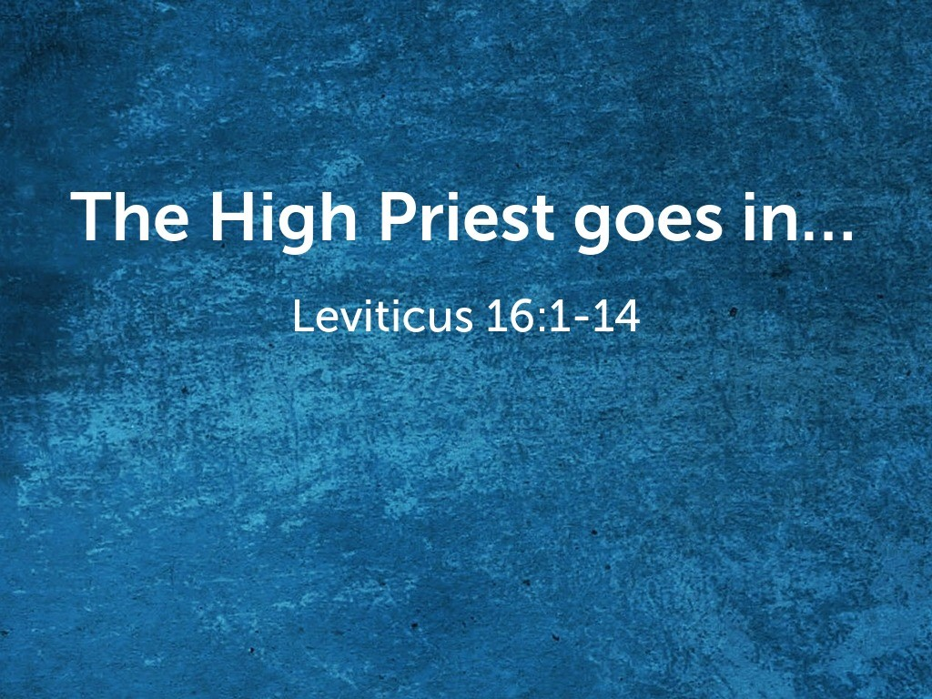

Slide 6

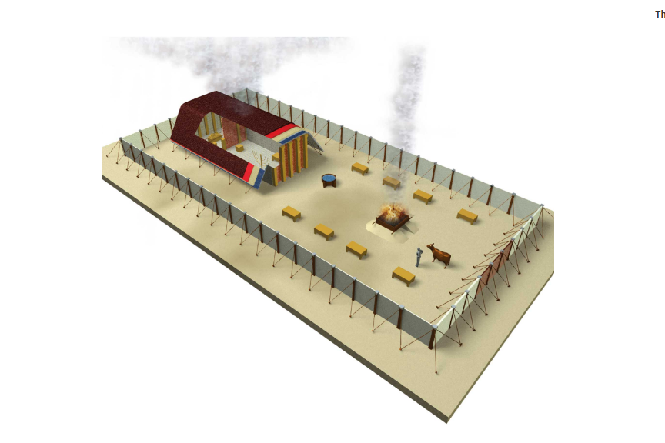
Most Holy Place
w/ Ark of the Covenant
Tent of Meeting
Altar
Courtyard

Slide 7
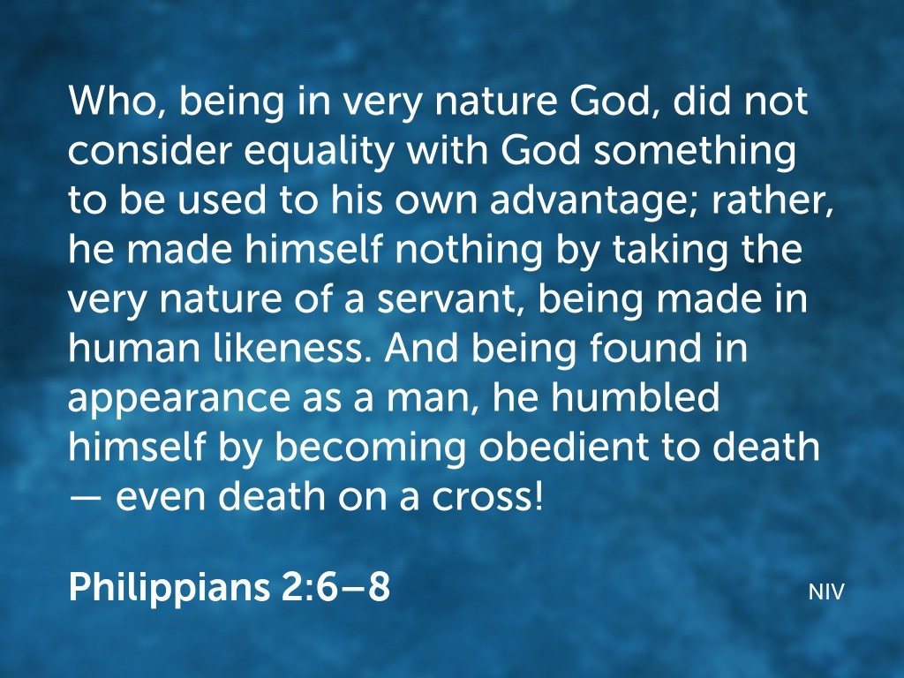

Slide 8
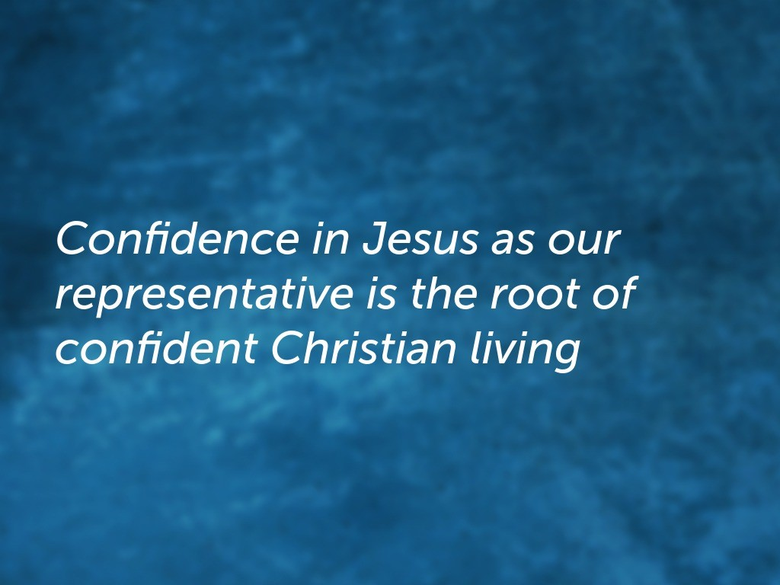

Slide 9


Slide 10
Most Holy Place
w/ Ark of the Covenant
Tent of Meeting
Altar
Courtyard

Slide 11
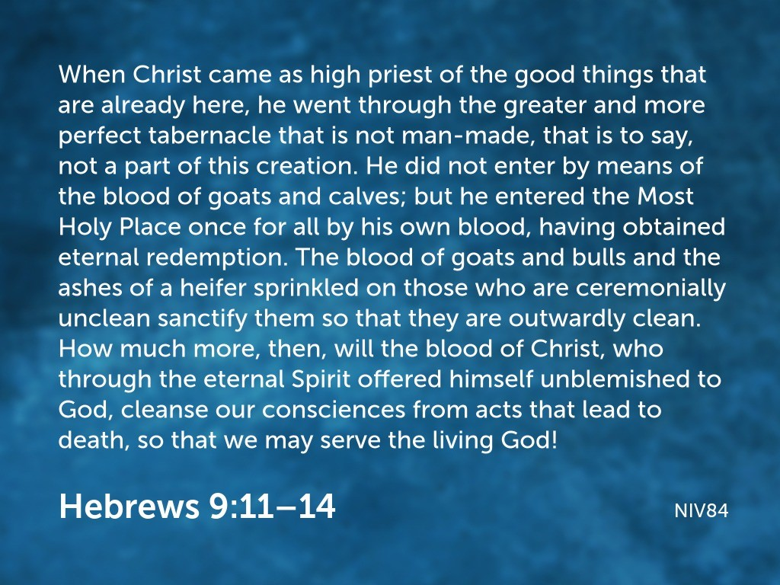

Slide 12
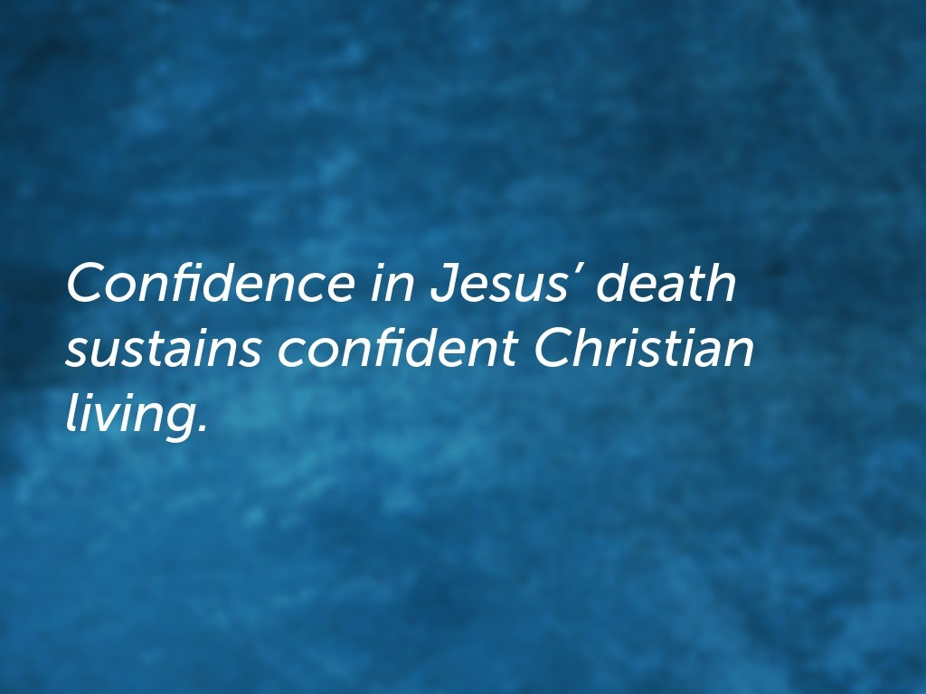

Slide 13
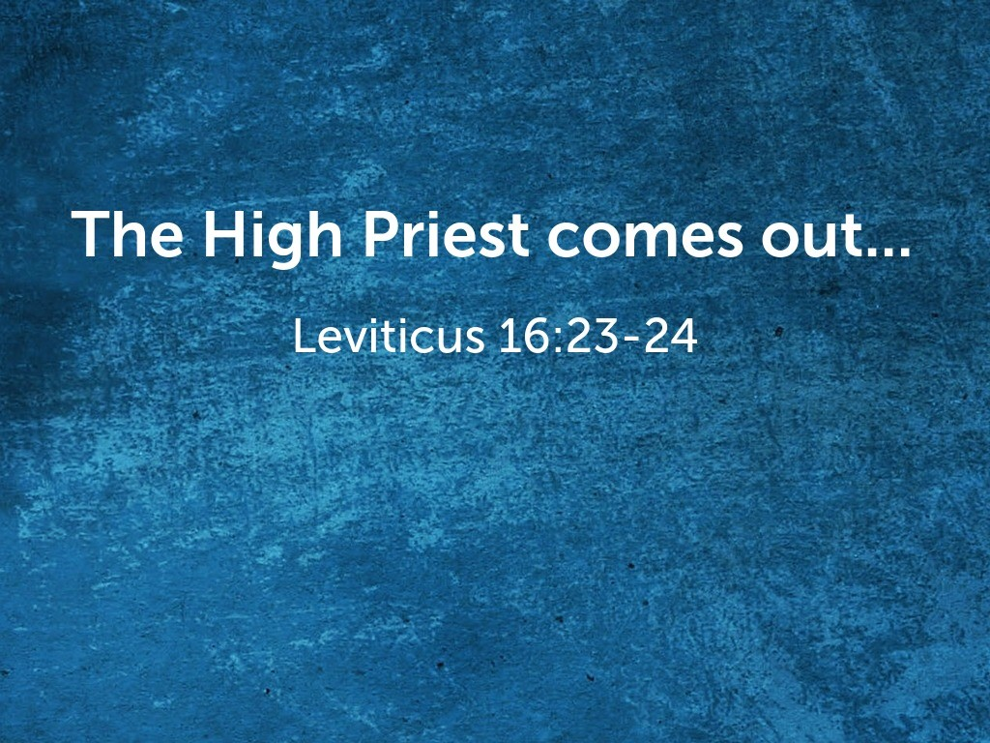

Slide 14
Most Holy Place
w/ Ark of the Covenant
Tent of Meeting
Altar
Courtyard

Slide 15
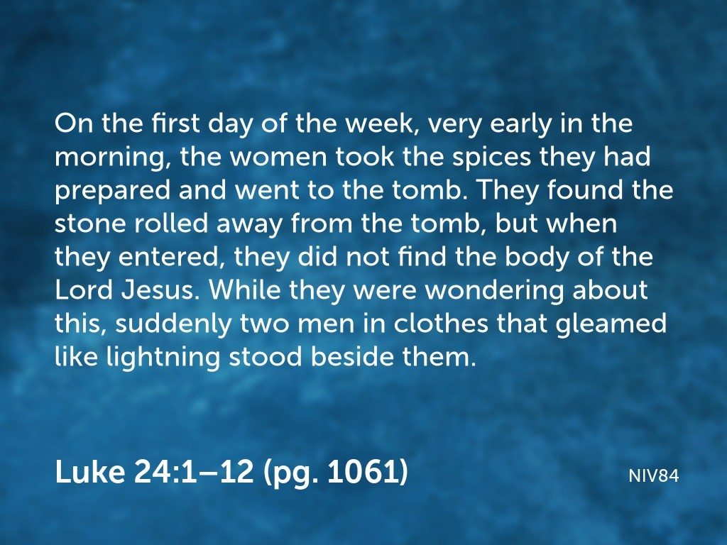

Slide 16
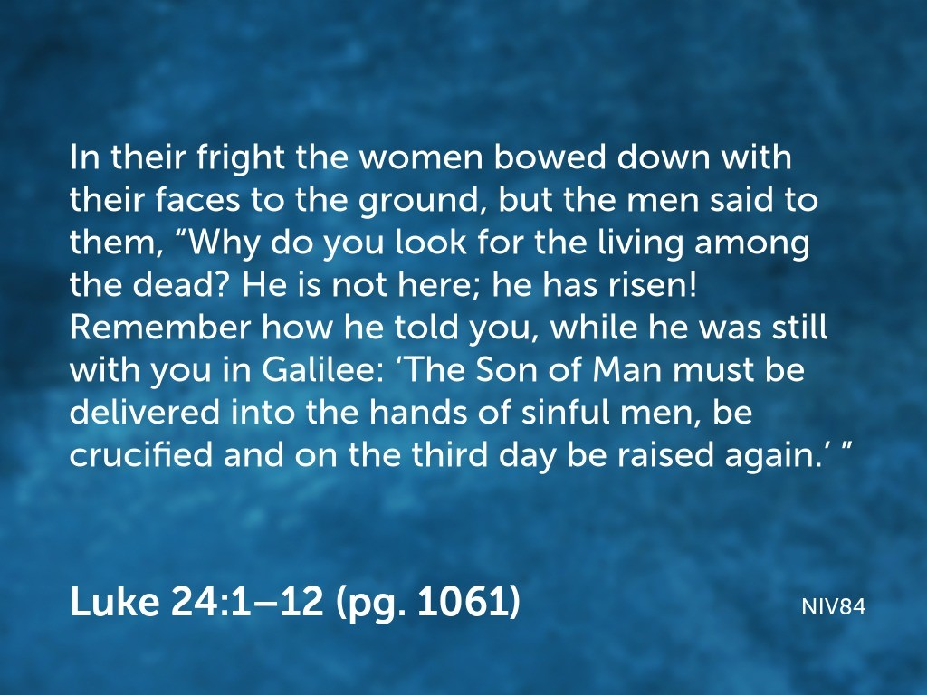

Slide 17
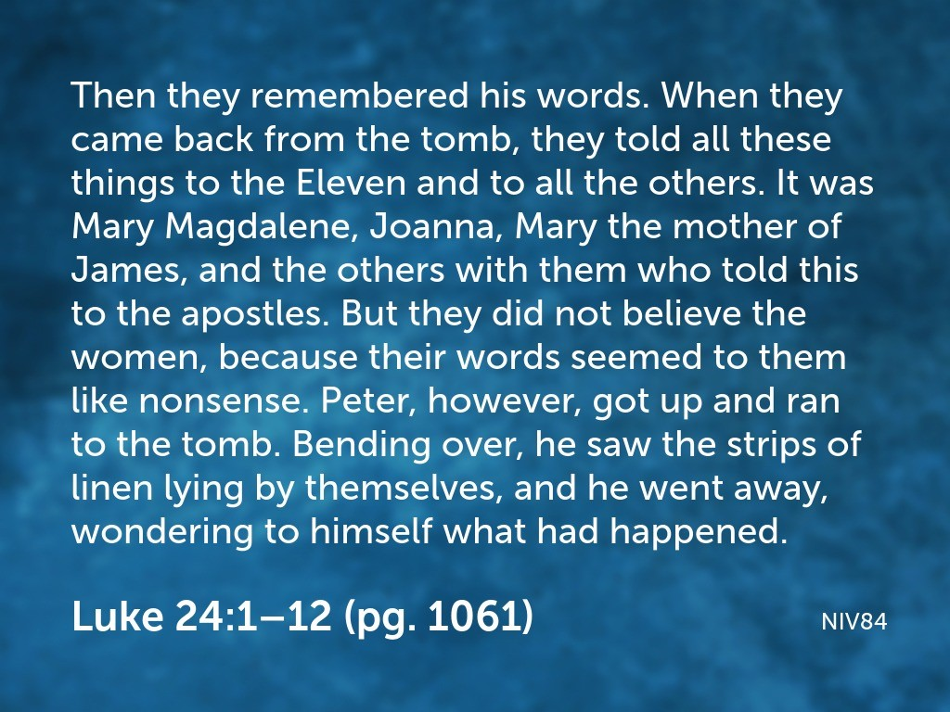

Slide 18
Most Holy Place
w/ Ark of the Covenant
Tent of Meeting
Altar
Courtyard

Slide 19
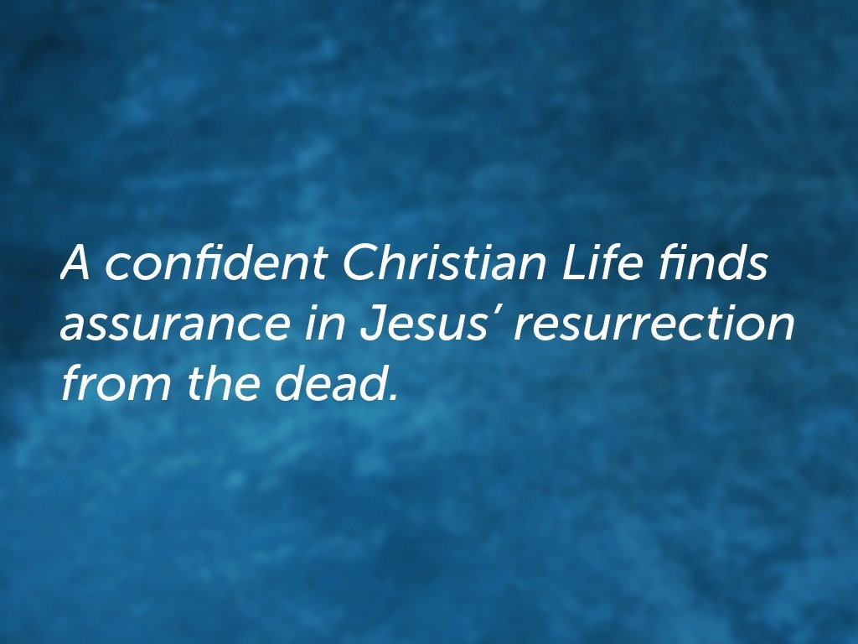

Slide 20


